Slide 1
SQL Programming
Rollups and Cubes

Slide 2
Module 15: Cubes and Rollups Page A-1: Intro
SQL was originally designed as the query language for relational database systems. Querying and retrieving information from the database was one of the prime motivations in developing SQL.
So it should come as no surprise then, that as SQL is revised and updated, newer versions of the standard continue to expand the reporting capabilities of the language.
The SQL:1999 standard provides some new features that are particularly useful when summarizing information. These new features are extensions to the GROUP BY clause and allow the programmer to ROLLUP or CUBE the result table.

Slide 3
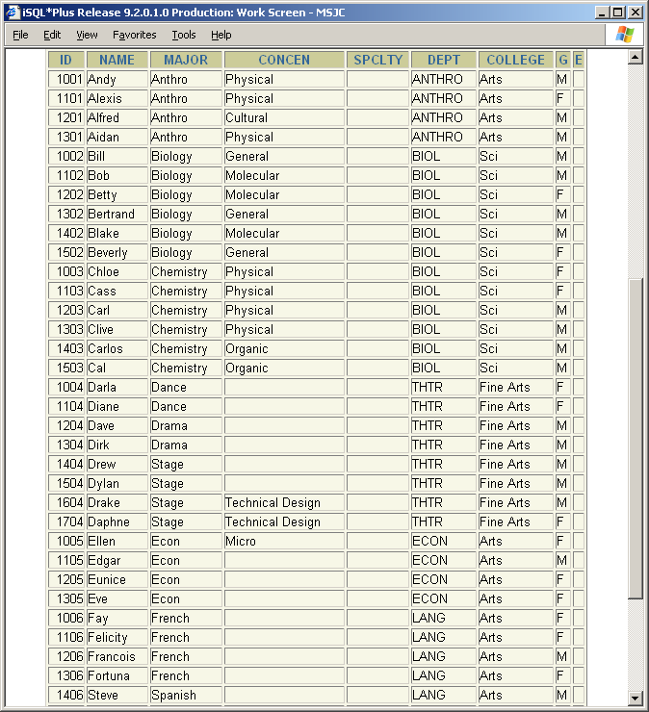
Module 15: Cubes and Rollups Page B-1: ROLLUP
Here’s a table with student related information.
By way of background,
Students choose a major.
Some majors offer the student the option to select a concentration, and all a concentration really is, is a ‘concentrated’ subprogram of study within a major.
Majors are offered by departments on campus.
And in the administrative scheme of things Departments belong to colleges.

Slide 4
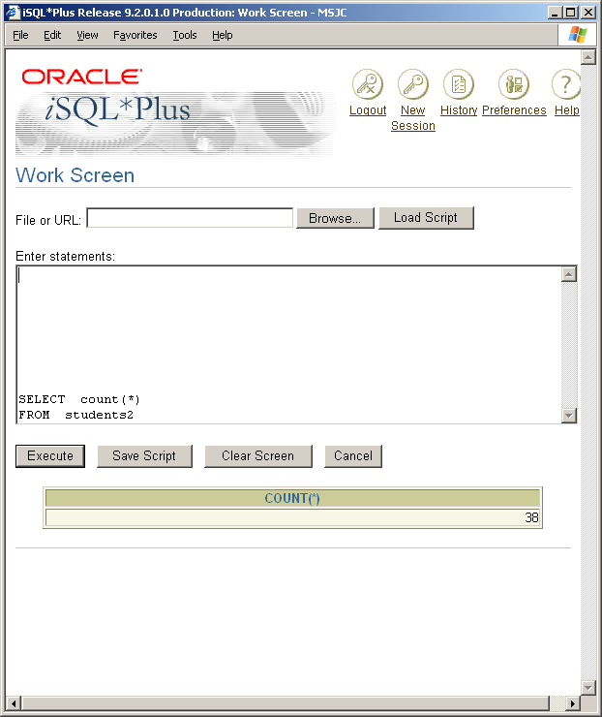
Module 15: Cubes and Rollups Page B-2: ROLLUP
If I asked you to tell me how many students there are, we could answer that question with one of the group, or aggregate, functions.
COUNT(*) tells us how many rows there are in the table.

Slide 5
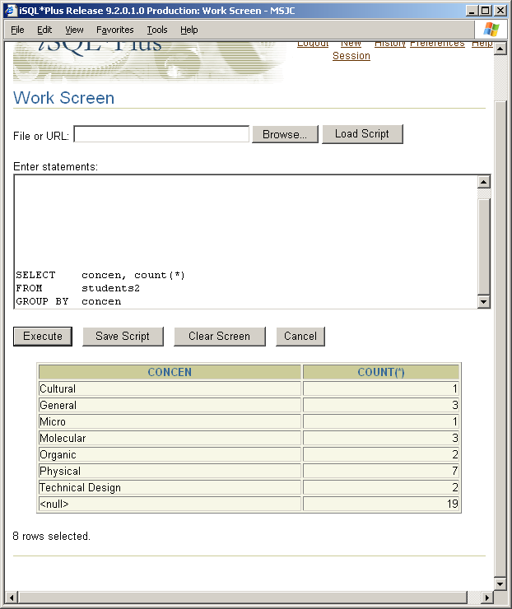
Module 15: Cubes and Rollups Page B-3: ROLLUP
If we wanted a more specific breakdown, say, how many students there are in each of the different concentrations, we could answer that question by using a GROUP BY clause.
Note: this use of COUNT(*), will include null values, whereas a COUNT(concen) would omit NULL values from the tally.
Note also that coincidentally, there are 19 students in concentrations, and there are also 19 students who have not selected a concentration.

Slide 6
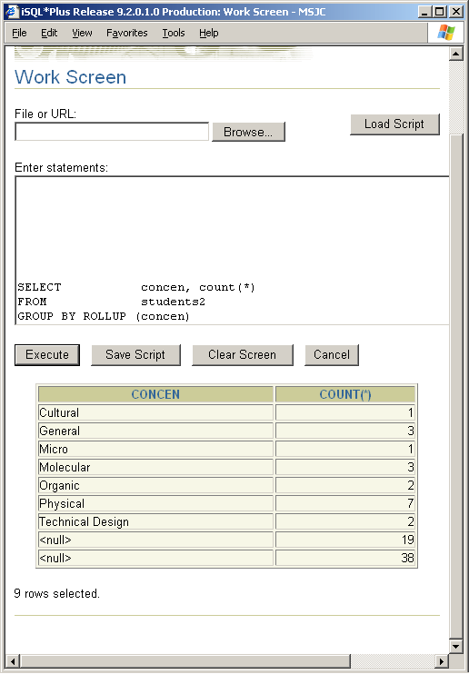
Module 15: Cubes and Rollups Page B-4: ROLLUP
But what can we do if we’re asked to expand the previous breakdown of students by concentration, and to now include a grand total?
The only techniques that we’ve studied so far require us to run two separate queries, (or maybe go thru some convoluted table unions, …)
But the SQL:1999 standard provides an extension to the GROUP BY clause that can help us with this problem.
That extension is the ROLLUP keyword, and you can think of ROLLUP as a handy way to generate subtotals and grand totals, as the accompanying example demonstrates.

Slide 7
Module 15: Cubes and Rollups Page B-5: ROLLUP
The ROLLUP keyword immediately follows the GROUP BY keyword.
And the columns that are being ‘rolled up’ are depicted in a parenthetically-enclosed list. A simple GROUP BY clause does not use parentheses to surround the columns, but GROUP BY ROLLUP does require the use of parentheses.
In this example, we’re only rolling up on the concen column, so what we’ll get will be the COUNT for each concentration (even NULLs), and a grand total that depicts the total count of all concentrations.
The counts by concentration are the old set, or aggregate, values that are generated by the GROUP BY. The grand total, which essentially adds up these aggregates, is referred to as a supper-aggregate, and that’s the value, in this example, that’s specially generated by the ROLLUP.

Slide 8
Module 15: Cubes and Rollups Page B-6: ROLLUP
Now this is another of those pretty cool SQL:1999 features that can save the programmer/developer a lot of time when responding to user inquiries, ...
But I think the implementation leaves a bit to be desired.
It’s a bit of a stretch to interpret this table.
In those last two rows, we have two values that are identified as nulls.
One of those nulls represents the actual count for NULL value records (19).
The other null row represents the super-aggregate value, that is the grand total.
That’s pretty hard to decipher, but there is a key feature about ROLLUPS that we can use to read the table, and that is that the grand-totals, and super-aggregate values always follow their respective aggregate rows.
Still, it would be nice if there were something more.

Slide 9
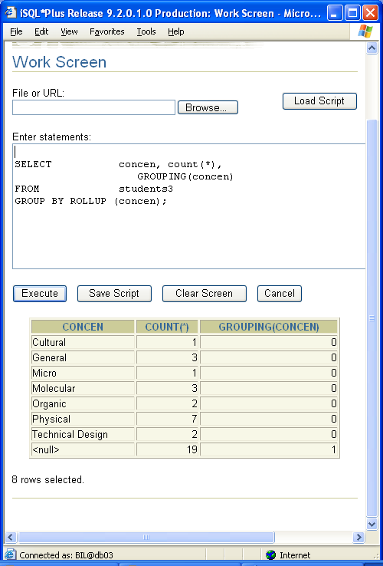
Module 15: Cubes and Rollups Page B-7: ROLLUP
And there is.
SQL:1999 provides a new function, the GROUPING function, that indicates whether the values in this row represent super-aggregate values for the specified column, or not.
The GROUPING function returns one of two values: 0 and 1.
1’s represent super-aggregate values.
In this example, the value 1 in the GROUPING(concen) column, (which is depicted in the very last row of the result table), indicates that the concen value has been super-aggregated for this row. That is, the value 19, in the COUNT(*) column has been super-aggregated for all of the concen values, this is the grand total.

Slide 10
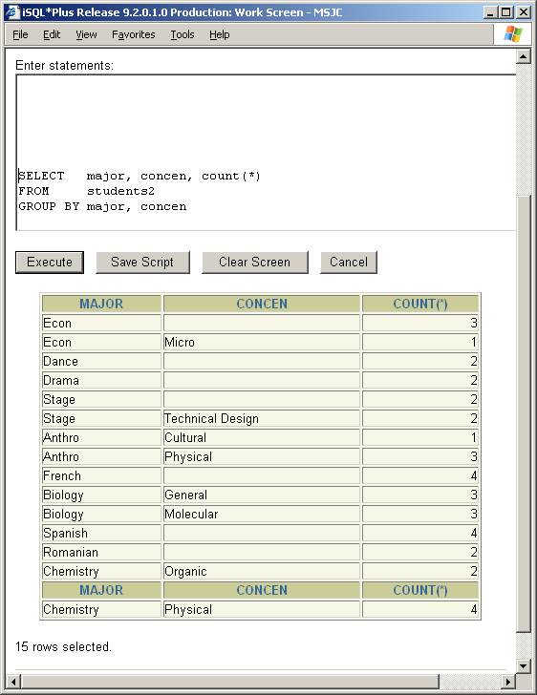
Module 15: Cubes and Rollups Page B-8: ROLLUP
Now a ROLLUP on a single column is relatively trivial, so let’s see what happens when we ROLLUP on more than one column of data.
Here’s the ‘simple’ group by result on majors and concentrations.

Slide 11
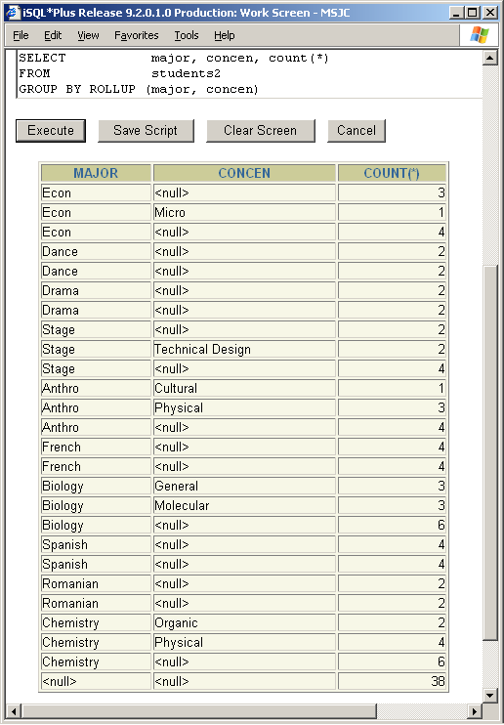
Module 15: Cubes and Rollups Page B-9: ROLLUP
Looking at the result table from the ROLLUP version, we can see right away that we’ve got quite a few more rows in our result table.
Let’s try it with the GROUPING function and see if we can more readily make sense of the results.

Slide 12
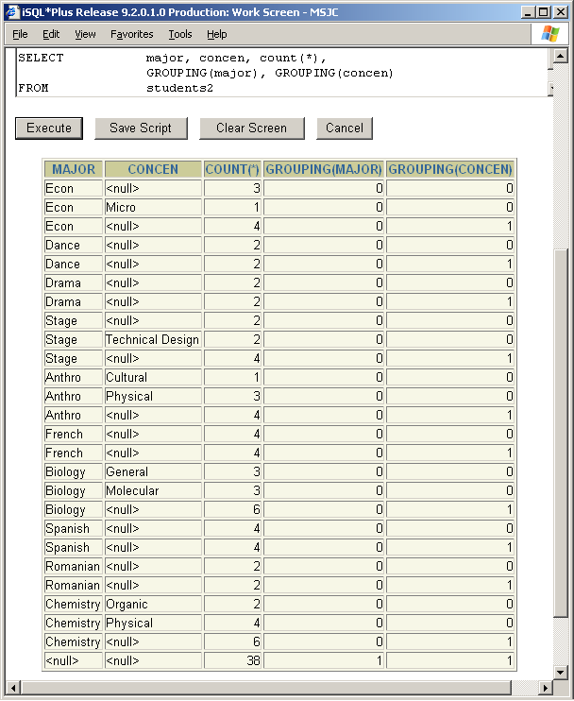
Module 15: Cubes and Rollups Page B-10: ROLLUP
Reading down the rightmost column, which is created by the GROUPING(concen) call, let’s focus on the rows with 1’s.
These rows represent the super-aggregates, or subtotals for these concentrations within their major.
Essentially, these are the sums of the preceding rows.
There are no 1’s in the major column until we get to the end of the listing, and that makes sense. The numbers for majors don’t have anything to be aggregated into, other than the grand total.
That last row then is the grand total row.

Slide 13
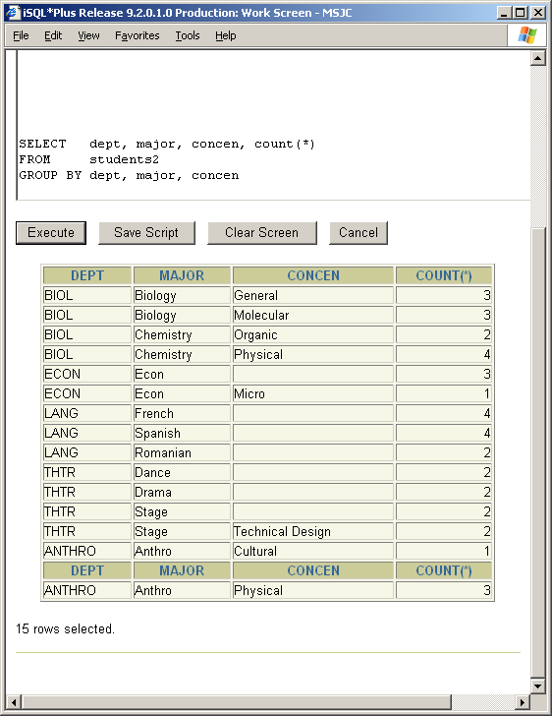
Module 15: Cubes and Rollups Page B-11: ROLLUP
Let’s add another column to the mix, and walk thru this again.
Here’s our simple GROUP BY, and the next couple of slides will demonstrate the ROLLUP, along with a ROLLUP using a GROUPING function.

Slide 14
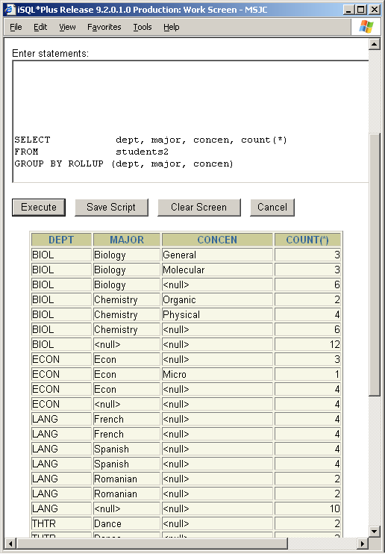
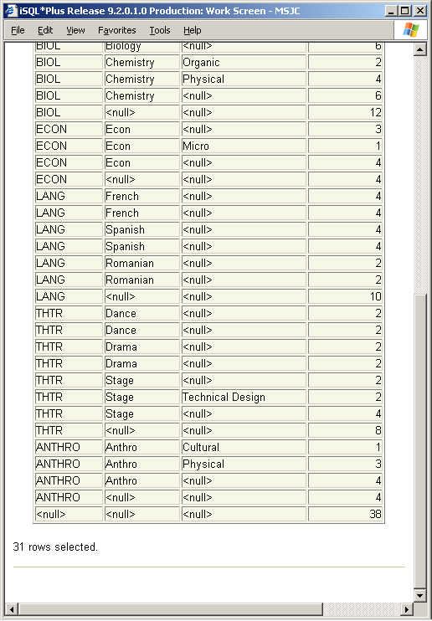
Module 15: Cubes and Rollups Page B-12: ROLLUP

Slide 15
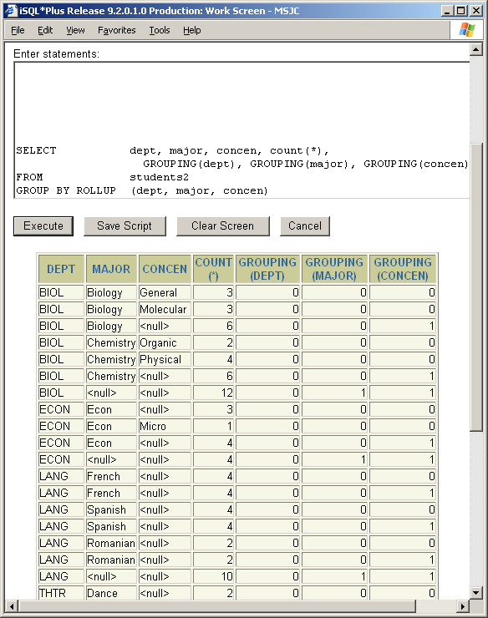
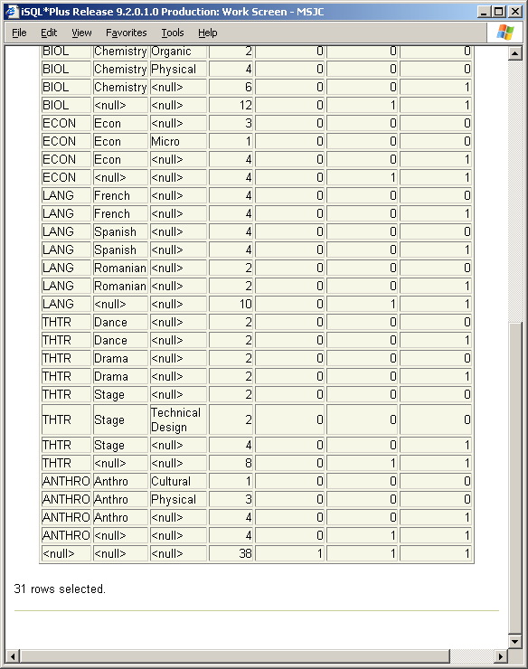
Module 15: Cubes and Rollups Page B-13: ROLLUP

Slide 16
Module 15: Cubes and Rollups Page B-14: ROLLUP
You’ll see that the GROUPING function now returns a 1 in the GROUPING(major) column to highlight those super-aggregate values.

Slide 17
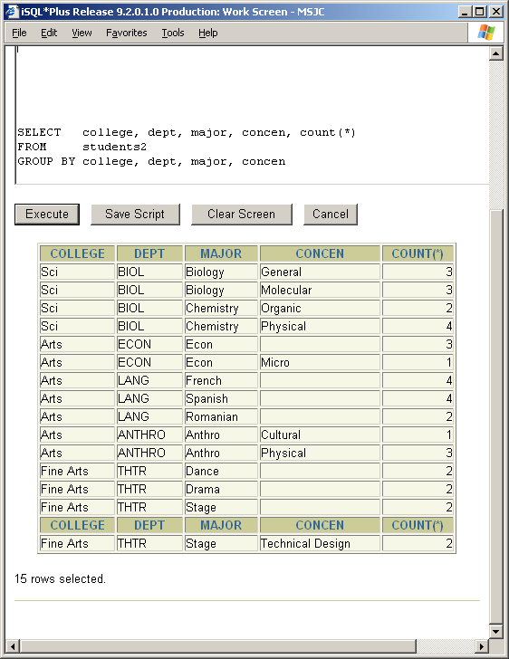
Module 15: Cubes and Rollups Page B-15: ROLLUP
One more ROLLUP example. This time we’ll add the college column to the mix.
Here’s the simple group by result.

Slide 18
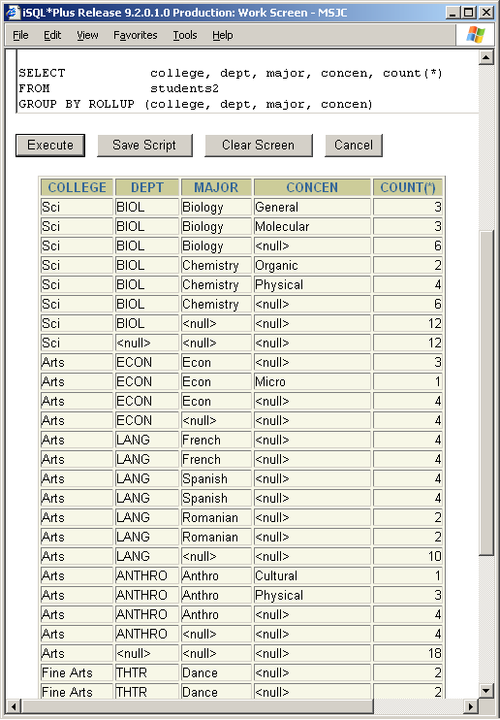
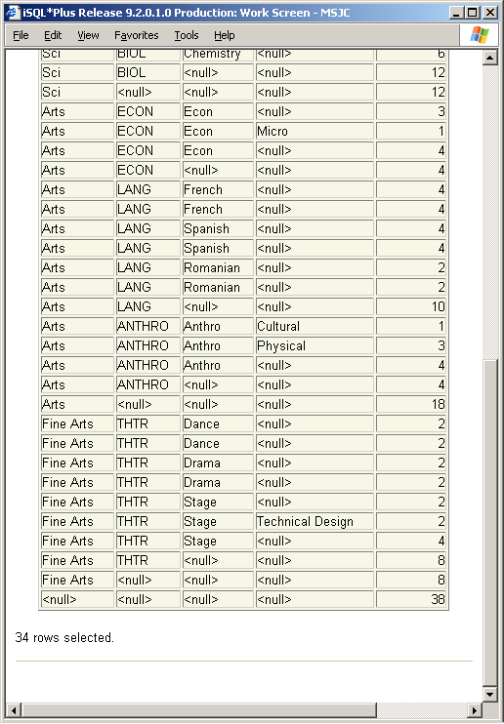
Module 15: Cubes and Rollups Page B-16: ROLLUP

Slide 19
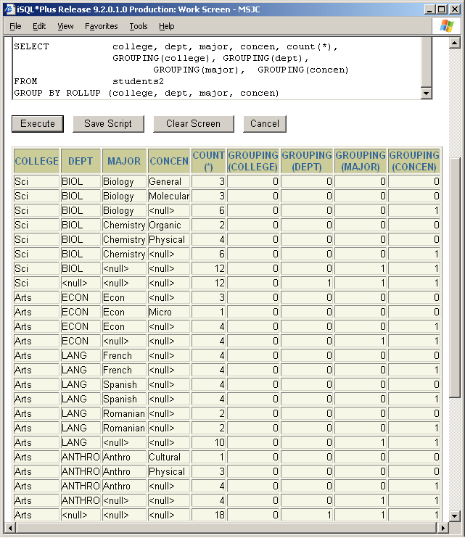
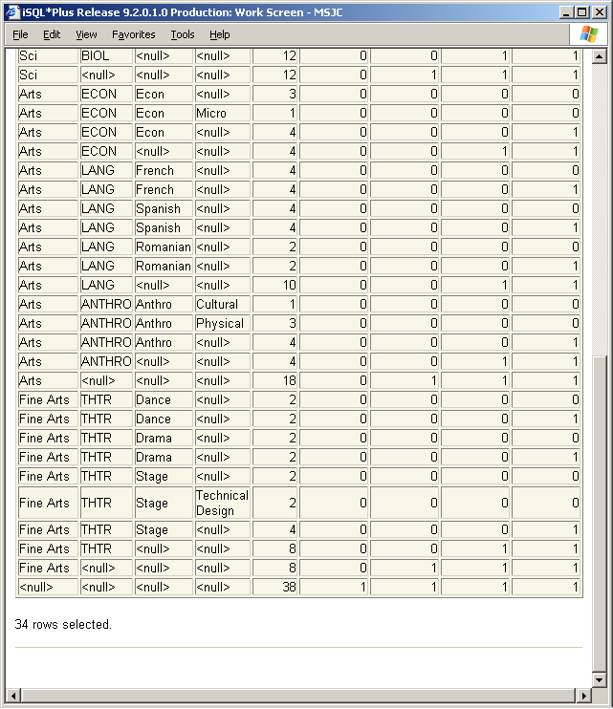
Module 15: Cubes and Rollups Page B-17: ROLLUP

Slide 20
Module 15: Cubes and Rollups Page B-18: ROLLUP
I expect that by now you’re able to anticipate all of the rows that will be presented in any result table that’s created with a ROLLUP clause.
Right?
Our student table (students2) contains 38 rows. The concentration column contains 7 different values, as well as the null value. If we ROLLUP on only the concentration column (concen) how many rows will there be in the result table?

Slide 21
Module 15: Cubes and Rollups Page B-19: ROLLUP
I expect that by now you’re able to anticipate all of the rows that will be presented in any result table that’s created with a ROLLUP clause.
Right?
Our student table (students2) contains 38 rows. The concentration column contains 7 different values, as well as the null value. If we ROLLUP on only the concentration column (concen) how many rows will there be in the result table?
8 aggregate rows for each concentration and NULL concentration
1 super-aggregate row for the grand total.

Slide 22
Module 15: Cubes and Rollups Page B-20: ROLLUP
Predicting the number of rows should always be doable if you’re only dealing with a single rollup column.
Once you get into 2 or more columns, you really need to understand the data options and the possible combinations.
But, if we had a table with 3 concentration possibilities for each major, and we had 4 majors, then our rolled-up result table would include:

Slide 23
Module 15: Cubes and Rollups Page B-21: ROLLUP
Predicting the number of rows should always be doable if you’re only dealing with a single rollup column.
Once you get into 2 or more columns, you really need to understand the data options and the possible combinations.
But, if we had a table with 3 concentration possibilities for each major, and we had 4 majors, then our rolled-up result table would include:
4*3 aggregate rows for each concentration
4 super-aggregate rows for the majors
1 super-duper-aggregate row for the grand total.

Slide 24
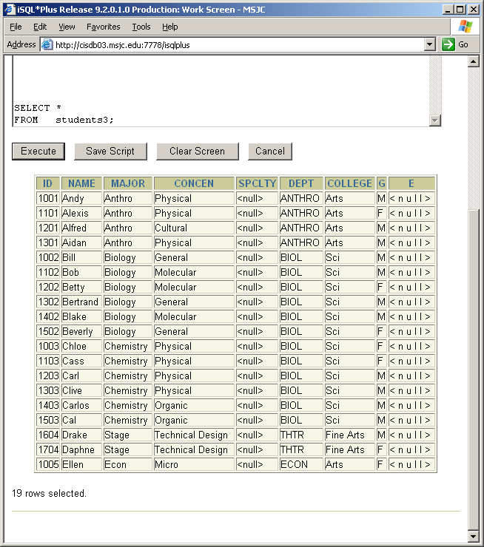
Module 15: Cubes and Rollups Page C-1: Cubes
CUBE-ing is yet another extension to the GROUP BY operation that became available in the SQL:1999 standard.
When you think of a cube, I’m sure the first thing that pops into your mind is the notion of a three-dimensional object, perhaps a box, or a pair of die.
Hang onto that notion.
With Cube operations we look at the data ‘every which way’, in every possible permutation, in every possible combination of values.
Let’s start with a few examples.
And to simplify matters, I’ll use the same student data that we used for ROLLUPs, but I’ll eliminate all those rows where the concen values are NULL.

Slide 25
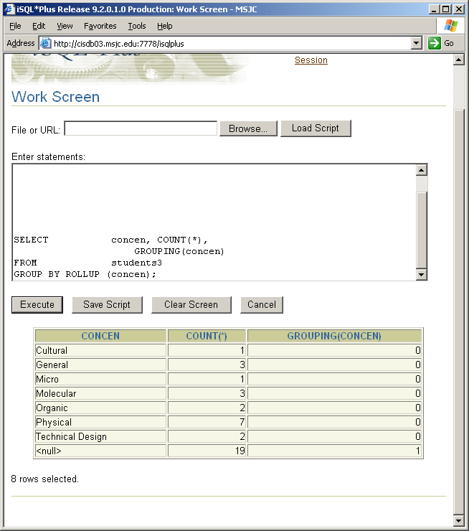
Module 15: Cubes and Rollups Page C-2: Cubes
Our ROLLUP on the single column concen produces a result table that summarizes the number of records by each different concen value, and then provides a grand total.
Think of this as a one-dimensional view of the data. We just looking ‘down’ on the concen values.

Slide 26
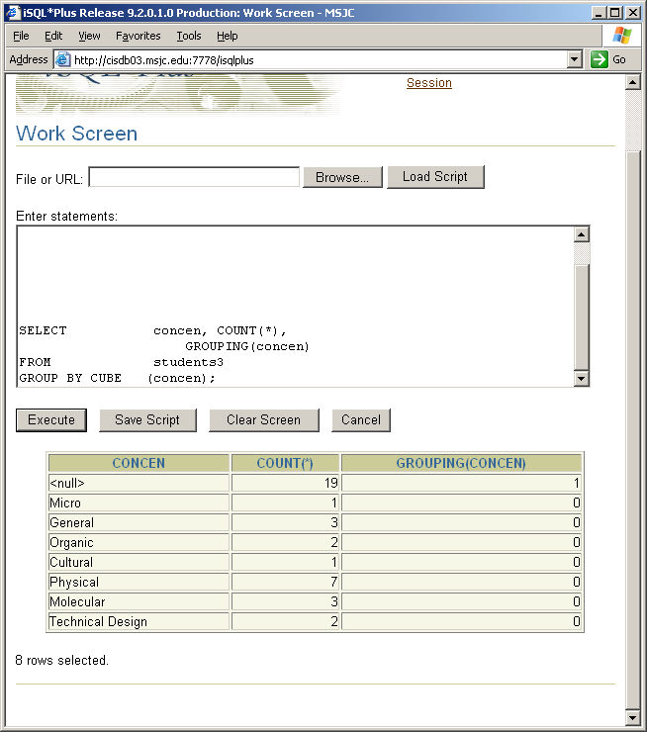
Module 15: Cubes and Rollups Page C-3: Cubes
Our CUBE operation produces the same table.
This is exactly as it should be. There’s only one variable to contend with, no other variables to interact with, so really all we can do is ‘look down’ on this single variable.

Slide 27
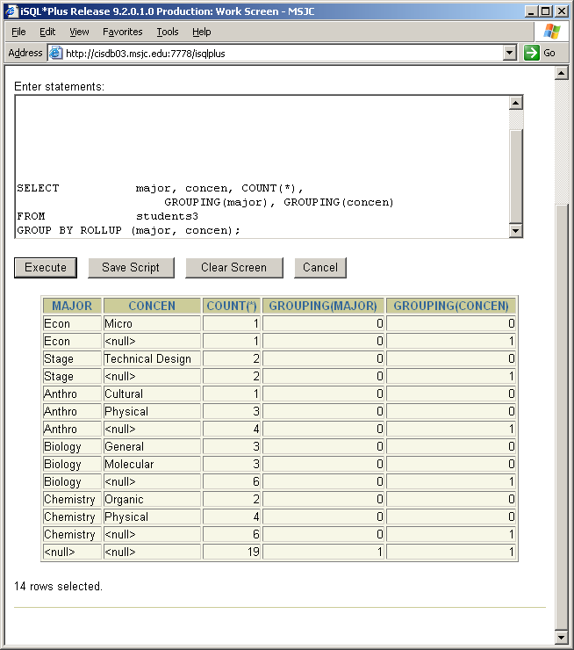
Module 15: Cubes and Rollups Page C-4: Cubes
This ROLLUP operation on the columns major and concen produces a report, again, from the ‘looking down’ perspective, on the data.
Each concen value, within a major is depicted and summarized. And then subtotals are produced for each major, and finally, a grand total is depicted.
We’re looking down on the data, and as the case is with rollups, you can think of the data as having been sorted. In this example, concentration values sorted within their respective majors. And as SQL cycles through the rows in the table, it ‘knows’ to generate a summary line (super-aggregate value) whenever one of the key columns changes value.

Slide 28
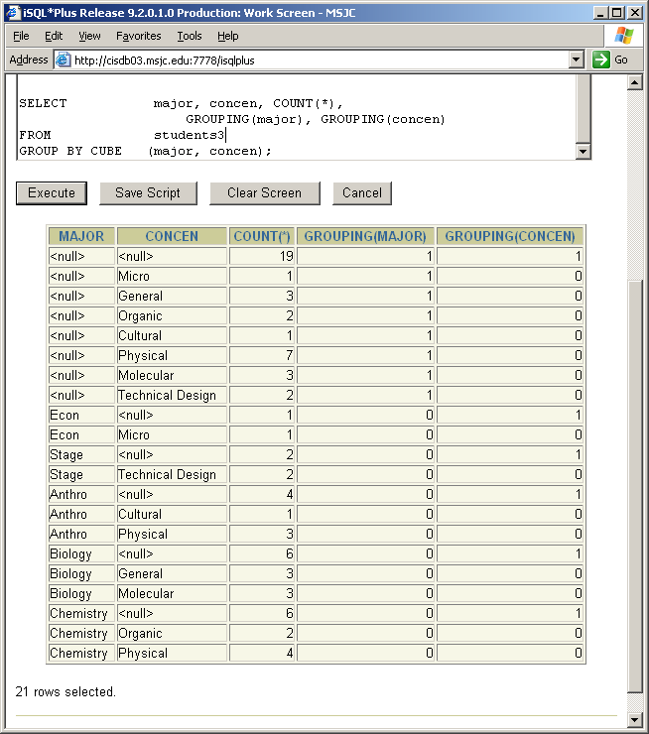
Module 15: Cubes and Rollups Page C-5: Cubes
The CUBE operation on these same tow columns extends the number of rows being generated from 14 to 21.
Where are these seven new rows in the result table? They’re the ones at the top of the result table (rows 2 thru 8).
And notice the new information they provide. These rows summarize, that is they super-aggregate, the concen values – independent from the major values.
Notice the value for ‘Physical’ in these new rows. It’s 7. And that value (7) is the sum of the anthro-physical rows and the chemistry-physical rows.

Slide 29
Module 15: Cubes and Rollups Page C-6: Cubes
So, this operation:
SELECT major, concen, COUNT(*),
GROUPING(major), GROUPING(concen)
FROM students3
GROUP BY CUBE (major, concen);
Ought to generate these kinds of rows:
Aggregate rows for each major and concen pattern.
Summary rows for each major
Summary rows for each concen
Grand total

Slide 30
Module 15: Cubes and Rollups Page C-7: Cubes
Now did you happen to notice that there’s a pattern emerging here?
When we CUBEd a single column (concen) there were 2 kinds of rows produced in the result table:
Regular aggregate rows for concen
Grand total row
When we CUBEd two columns (major, concen) there were four kinds of rows produced:
Aggregate rows for each major and concen pattern.
Summary rows for each major
Summary rows for each concen
Grand total
How many row types will be generated when we CUBE 3 columns?

Slide 31
Module 15: Cubes and Rollups Page C-8: Cubes
Now did you happen to notice that there’s a pattern emerging here?
When we CUBEd a single column (concen) there were 2 kinds of rows produced in the result table:
Regular aggregate rows for concen
Grand total row
When we CUBEd two columns (major, concen) there were four kinds of rows produced:
Aggregate rows for each major and concen pattern.
Summary rows for each major
Summary rows for each concen
Grand total
How many row types will be generated when we CUBE 3 columns?
8

Slide 32
Module 15: Cubes and Rollups Page C-9: Cubes
If we focus on the value of the GROUPING function for each of the columns that we’re CUBEing, I think the pattern will become more clear.
When we CUBEd on a single column, concen, we noticed two values (2¹=2) in the GROUPING(concen) column:
0
1
When we CUBEd on two columns, major and concen, the pattern for their GROUPING functions was:
GROUPING(major) GROUPING(concen)
0 0
0 1
1 0
1 1
There are four kinds of rows/patterns (2²=4).

Slide 33
Module 15: Cubes and Rollups Page C-10: Cubes
So let’s revisit those programs and try to re-interpret the results in the context of the GROUPING function.
When we CUBEd on a single column, concen, we noticed two values in the GROUPING(concen) column:
0
1
The rows with 0 values represent aggregate (not super-aggregate) values for these different concen values.
The rows with 1 values represent super-aggregate values. All of the concen aggregate values get super-aggregated into the ‘next’ pattern up – which in this case becomes our grand total.

Slide 34
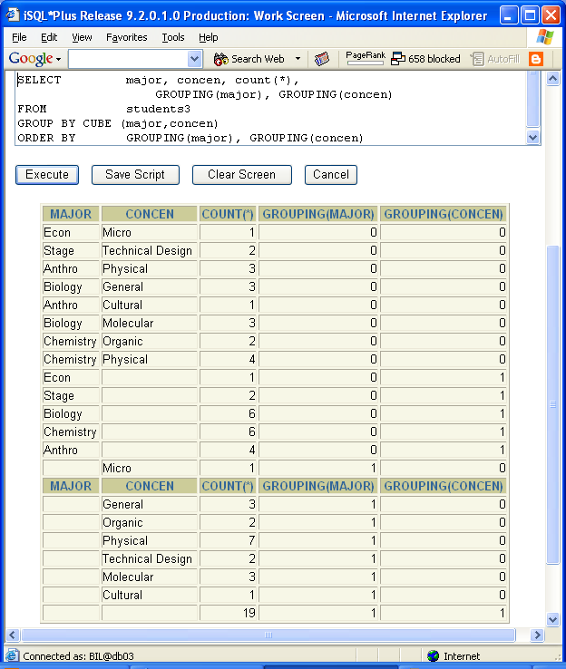
Module 15: Cubes and Rollups Page C-11: Cubes
When we CUBEd on two columns, major and concen, the pattern for their GROUPING functions was:
GROUPING(major) GROUPING(concen)
0 0
0 1
1 0
1 1
(0:0) simple aggregate values for these major and concen patterns
(0:1) super-aggregates for all of the concen values in this particular major pattern
(1:0) super-aggregates for all major values in this particular concen pattern
(1:1) super-aggregates for all major concen values, the grand total

Slide 35
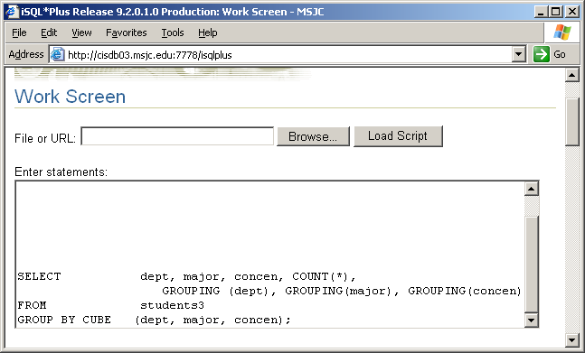
Module 15: Cubes and Rollups Page C-12: Cubes
Let’s try another cubing operation.
What do you think this will do?

Slide 36
Module 15: Cubes and Rollups Page C-13: Cubes
Let’s try another cubing operation.
What do you think this will do?
It ought to generate 8 different ‘kinds’ of rows (2³=8).
And once again, if we focus on the values that are generated by the GROUPING function, we could anticipate these patterns:
GROUPING (dept, major, concen)
0 : 0 : 0
0 : 0 : 1
0 : 1 : 0
0 : 1 : 1
1 : 0 : 0
1 : 0 : 1
1 : 1 : 0
1 : 1 : 1

Slide 37
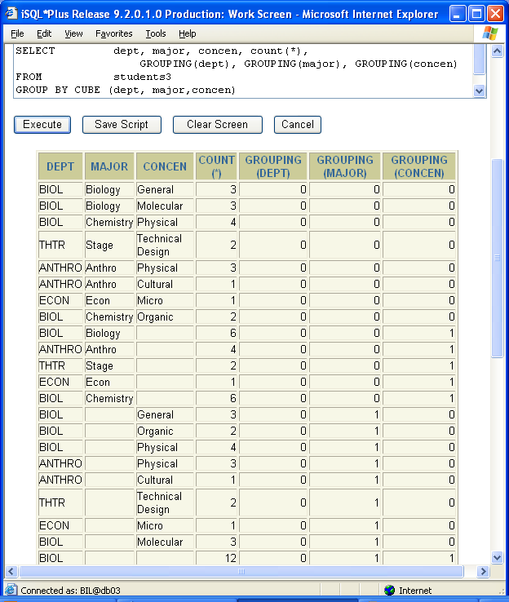
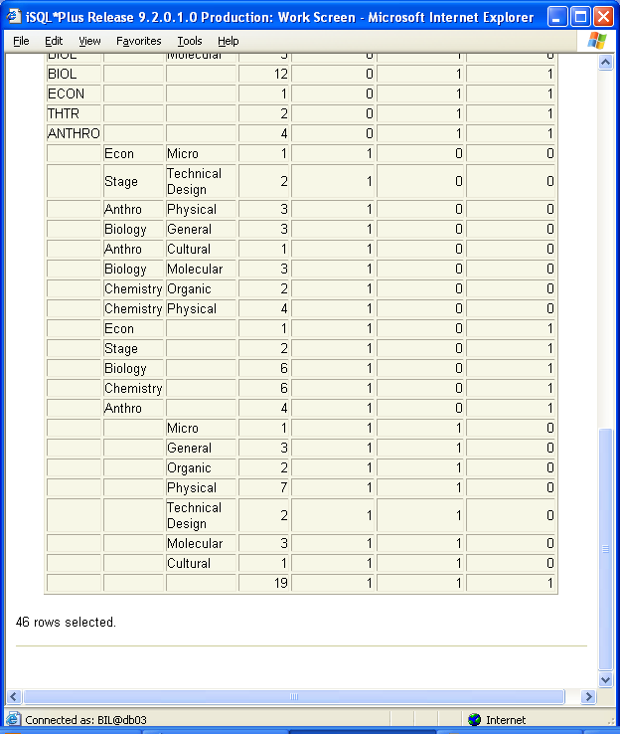
Module 15: Cubes and Rollups Page C-14: Cubes

Slide 38
Module 15: Cubes and Rollups Page C-15: Cubes
GROUPING (dept, major, concen)
0 : 0 : 0
0 : 0 : 1
0 : 1 : 0
0 : 1 : 1
1 : 0 : 0
1 : 0 : 1
1 : 1 : 0
1 : 1 : 1
(0:0:0) simple aggregate values for each and every one of the possible dept, major and concen patterns
(0:0:1) super-aggregate values for concentrations in a dept,major pattern - or how many of these dept-major patterns are there, regardless of the value in concen)
(0:1:0) super-aggregate values for majors in a dept-concen pattern – or how many of these dept-concen patterns are there, regardless of the value in major.

Slide 39
Module 15: Cubes and Rollups Page C-16: Cubes
GROUPING (dept, major, concen)
0 : 0 : 0
0 : 0 : 1
0 : 1 : 0
0 : 1 : 1
1 : 0 : 0
1 : 0 : 1
1 : 1 : 0
1 : 1 : 1
(0:1:1) how many of these departments are there, regardless of major and concen values.
(1:0:0) how many of these major concen patterns are there, regardless of the value in dept
(1:0:1) how many of these majors are there, regardless of the value in dept and concentration
(1:1:0) how many of these concentrations are there, regardless of the value in dept and major.
(1:1:1) how many of anything are there, regardless of the value on dept, major and concentration – ie the grand total.

Slide 40
Module 15: Cubes and Rollups Page T-1: Terminology
Group, set, aggregate function
Aggregates
Super-aggregates
Ordered super-aggregate rows
Rollup
cube
GROUPING function

Slide 41
Module 15: Cubes and Rollups Page Z-1: End Notes
Please drop me an email if you noticed any errors in this module. I’d also appreciate reading your comments, criticisms, and or suggestions as to how this module could be improved.
Were there any gaps in the information that was presented (ie. ‘leaps of faith’)?
Was any section unclear?
Did I happen to do a good job? ☺
Thanks,
bil

Slide 42
That’s All

